Slide 1

PROJECT WORK · ELECTRONIC ENGINEERING
Health Monitor Smartband Rev-01
From an unexplained Bluetooth fault to a validated, cloud-connected wearable
Masrur Jamil Prochchhod
Electronic Engineering — Mat.Nr. 2210028
Supervisors: Prof. Dr.-Ing. João Paulo Javidi da Costa · Dr. Giovanni Almeida Santos

Slide 2
Agenda
01
Motivation & Goals
05
GATT Profile & Sensors
02
System Architecture
06
Cloud, FHIR & Evidence
03
The Bluetooth Mystery
07
Evaluation & Limitations
04
Firmware Bring-Up Methodology
08
Outlook & Summary
Agenda
1

Slide 3
Motivation
Continuous, unobtrusive vital-sign monitoring supports faster clinical intervention
THE STARTING POINT
Low-cost wearable hardware makes this accessible outside hospital equipment
Rev1's Bluetooth stack was failing with a hardware exception fault.
A prior investigation blamed a genuine RF / silicon defect on the custom PCB.
A custom-built smartband — not a commercial tracker — gives full control over the sensor pipeline, wireless protocol, and backend
Essential for a system meant to eventually integrate with hospital patient records
Motivation & Goals
2

Slide 4
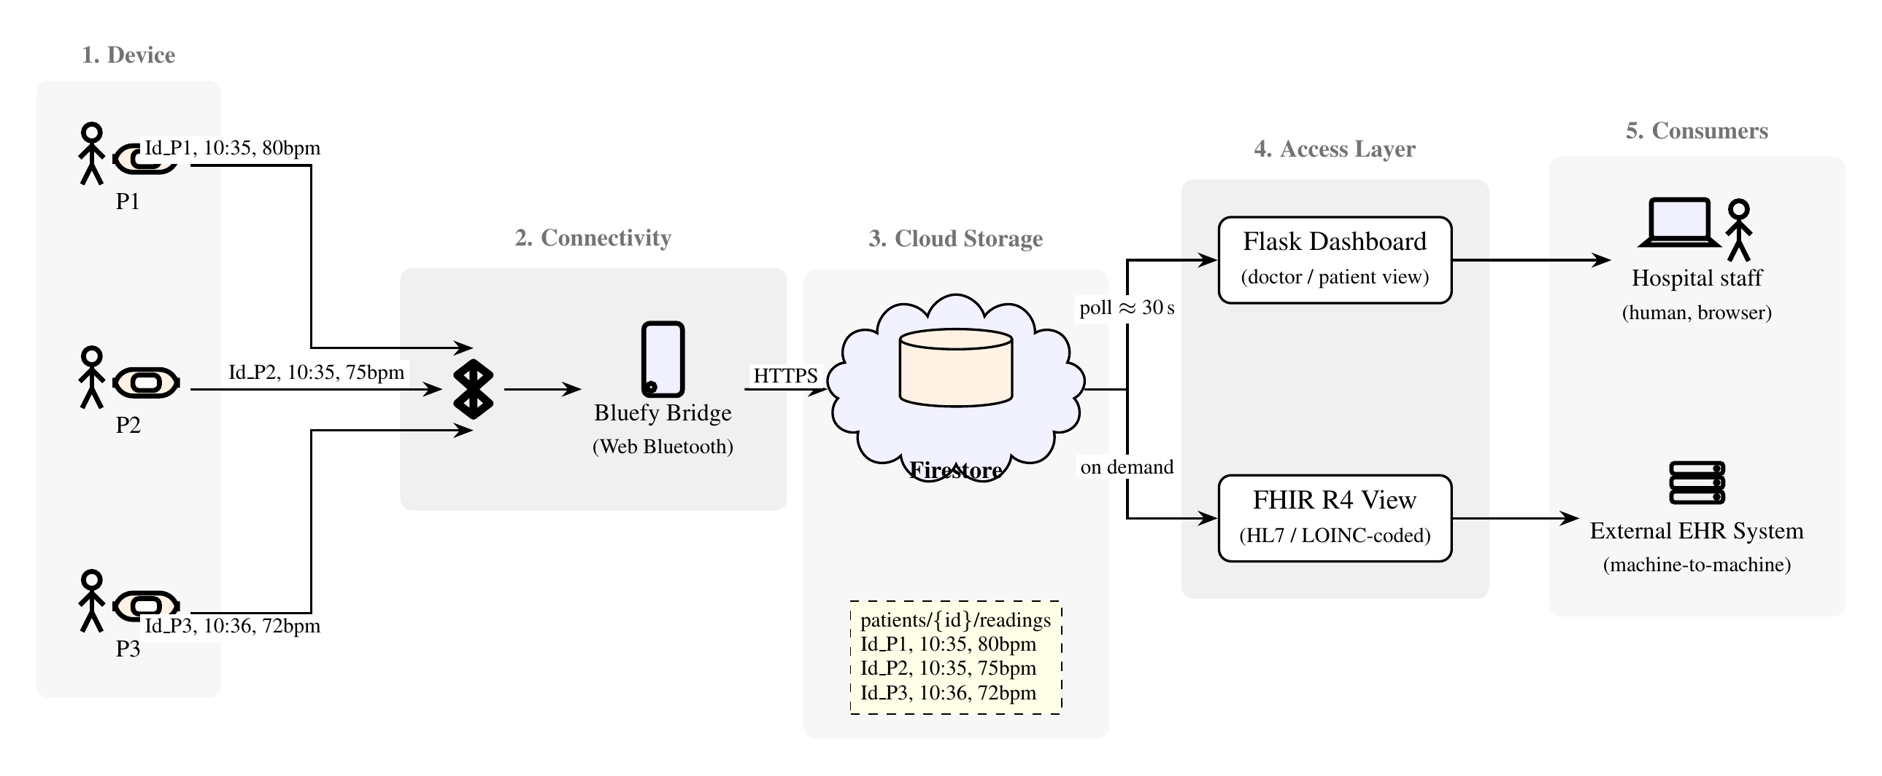
System Architecture
Figure 2.2 — Health Monitor Smartband system architecture
System Architecture
3

Slide 5
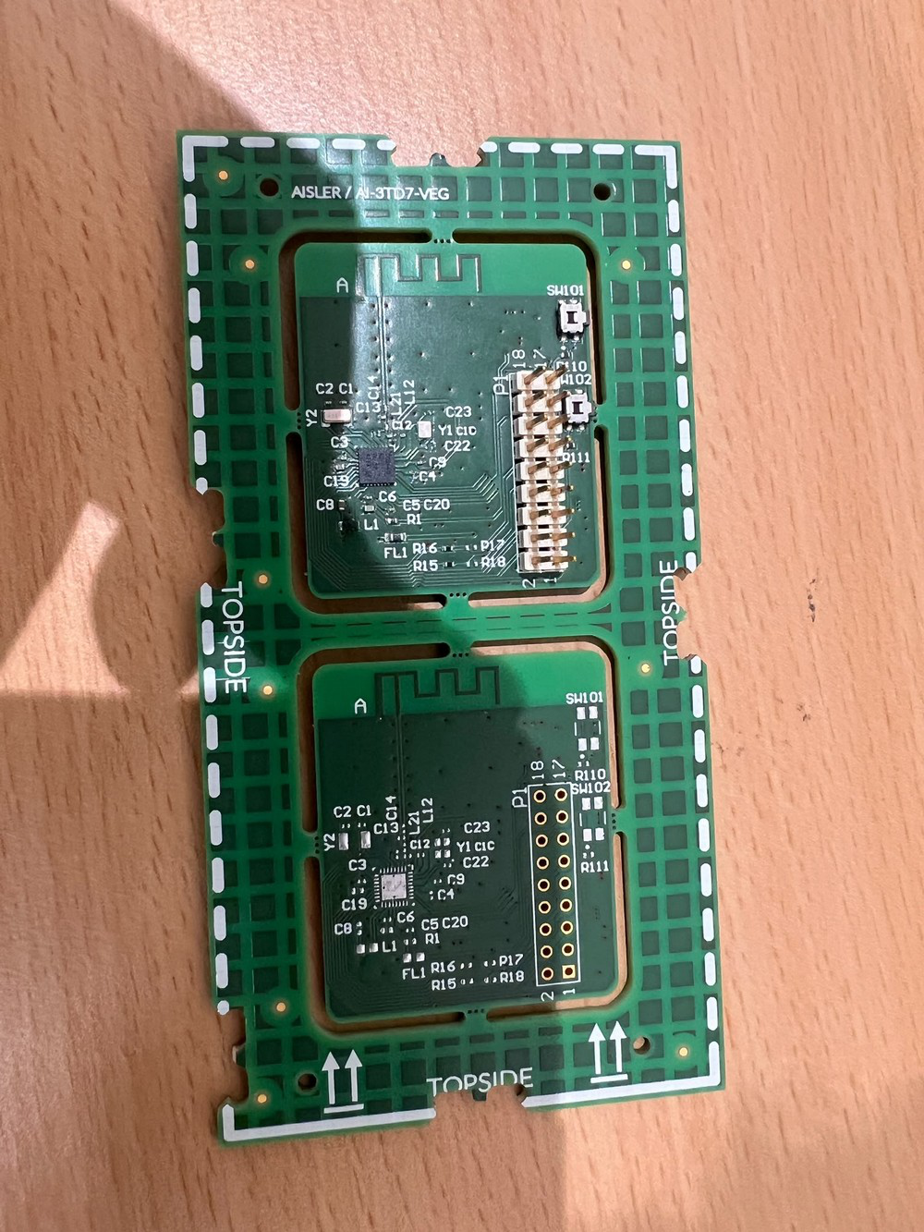
Hardware Platform
TI CC2640R2FRSMR — 32-bit Cortex-M3, BLE 4.2/5.0 SoC
MAX30102 — pulse-oximetry / heart-rate (PPG)
MAX30205 — clinical-grade digital temperature
LIS331DLTR — 3-axis MEMS accelerometer
SSD1306 OLED — on-device live readout
250 mAh LiPo battery + TP4056 charging
Figure 4.1 — Band01_Rev1 PCB, top side
System Architecture
4

Slide 6
THE INVESTIGATION
The Bluetooth Mystery
“The stack faults with a hardware exception inside GAPRole_StartDevice().”
Prior investigation's conclusion: a genuine RF or silicon-level defect
This project set out to test that assumption from first principles
The Bluetooth Mystery
5

Slide 7
Methodology: Clean Rebuild, Not a Patch
1
Start from TI's own, completely unmodified SDK examples
2
Add exactly one capability at a time — RTOS boot, UART, I2C, each sensor
3
Rebuild, reflash, and observe real hardware behaviour after every change
4
Treat every unexpected hang as a debugging opportunity, not a blocker
5
Delay reintroducing Bluetooth until the sensor firmware was fully proven
Bring-Up Methodology
6

Slide 8
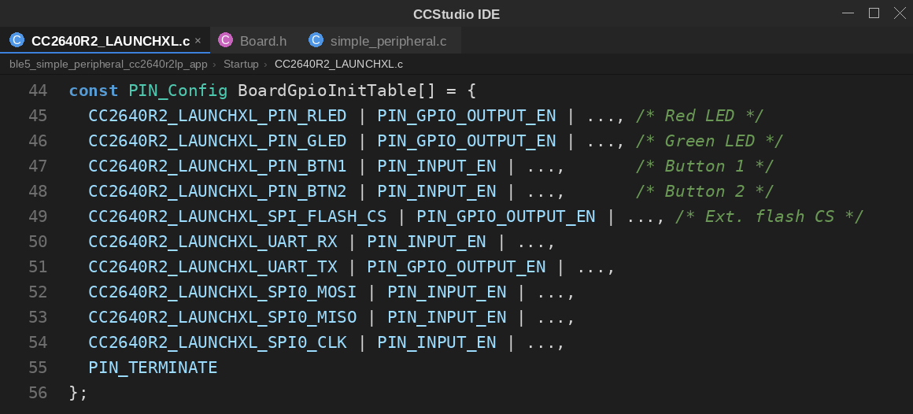
The Reveal — Finding the Bug
PIN_init() was silently failing at boot
Root cause: the stock LaunchPad board file configures LEDs, buttons, SPI flash
None of that hardware exists on Rev1's custom PCB
Same fault signature reappeared in an unmodified BLE example project
Listing 5.2 — Stock BoardGpioInitTable
The Bluetooth Mystery
7

Slide 9
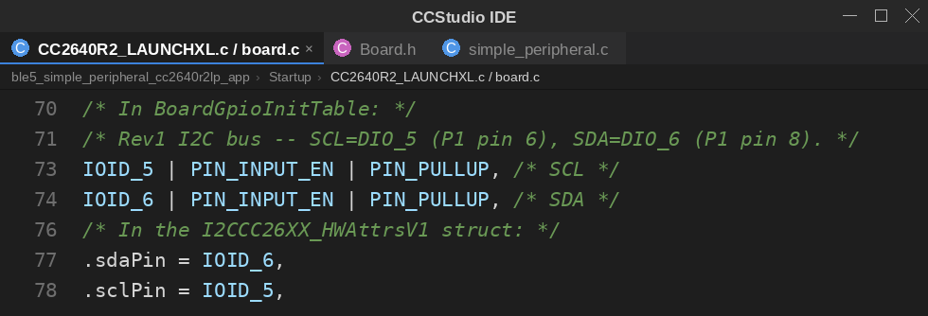
The Reveal — The Fix
Board files stripped to only the pins Rev1 actually has
Applying the same fix unblocked the original Bluetooth project cleanly
Confirmed independently with nRF Connect: full advertising + connection
Listing 5.5 — I2C pin correction, applied in two places
Rev1's CC2640R2F radio hardware was, and is, fully functional.
The Bluetooth Mystery
8

Slide 10
Bluetooth GATT Profile
Char. | Access | Contents | Format
CHAR1 | Read / Write | Temperature | 1 byte, whole °C
CHAR2 | Read | Accelerometer X | 1 byte, int8
CHAR3 | Write | Measurement-interval config. | 1 byte
CHAR4 | Notify | Heart rate + worn flag | 2 bytes
CHAR5 | Read | IR raw value (PPG proxy) | 5 bytes
CHAR4 widened from 1 byte to a 2-byte [BPM, worn] array
CHAR5 padded to satisfy a 5-byte length check, re-permissioned to drop an unnecessary pairing requirement
GATT Profile & Sensors
9

Slide 11
An Unplanned Detour: CCS 21 Migration
CCS 12.8.1 lost the ability to talk to the debug probe mid-project — 10 build-system issues, individually diagnosed:
Result: all ten resolved — clean, reproducible builds and full debug access restored.
Firmware Bring-Up
10

Slide 12
Cloud Bridge: From Sensor to Firestore
Bluefy browser connects over Web Bluetooth (the only iOS option supporting it)
1
Subscribes to CHAR4 notifications; polls CHAR1/CHAR2 every 5 seconds
2
Each value parsed and written into a per-patient Firestore document
3
Writes rate-limited to ~30s to stay within the Firestore free-tier quota
4
Cloud, FHIR & Evidence
11

Slide 13
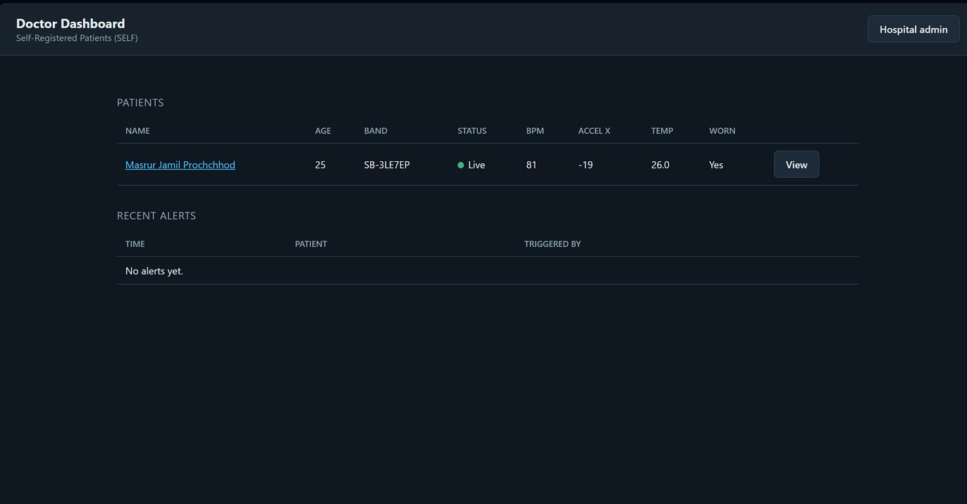
The Dashboard: What Hospital Staff See
Live heart rate, temperature, and acceleration for the selected patient
“Worn” status and a historical trend chart, updated as readings arrive
“Live” badge tied directly to Firestore's freshness window
Plain browser page — no app install needed on the hospital side
Figure 6.1 — Doctor-facing dashboard view
Cloud, FHIR & Evidence
12

Slide 14
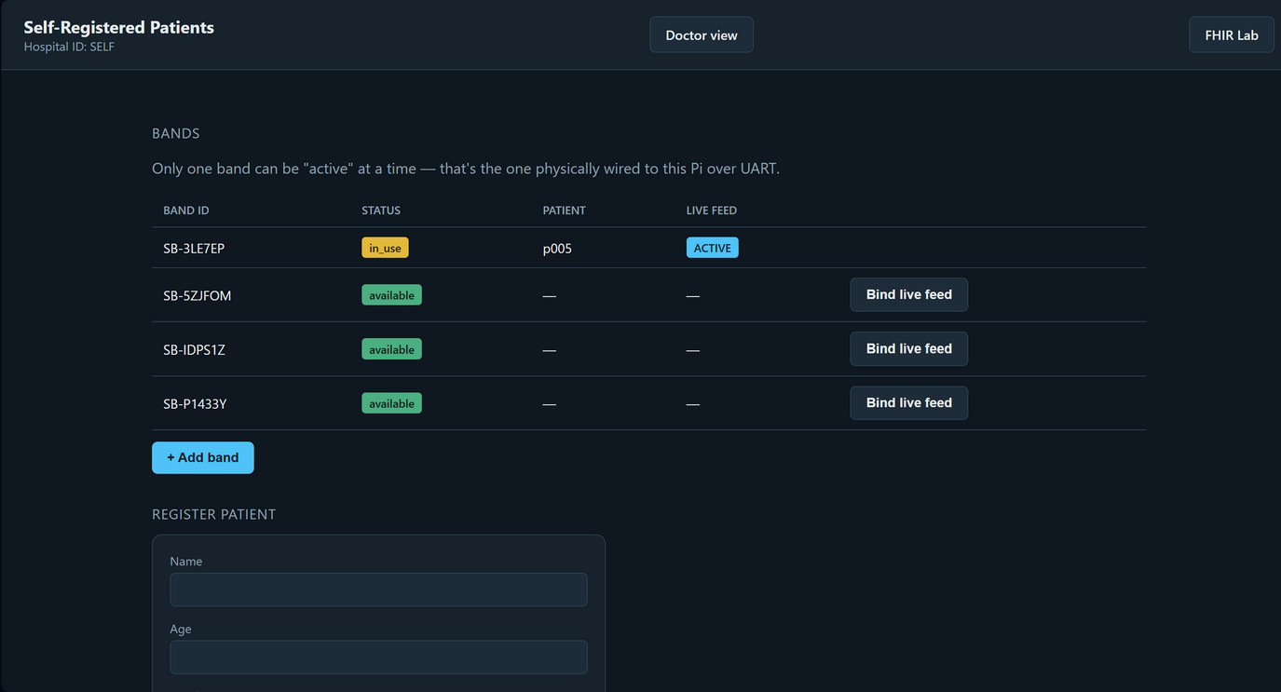
Patient Registration & Band Management
Patient self-registers once and receives a unique Band ID
Hospital admin binds a physical band to a patient via “Bind live feed”
Firestore schema keys every reading by patient ID from day one
Same architecture already supports multiple concurrent patients — even with a single physical unit today
Figure 5.1 — Self-registration & band binding
Cloud, FHIR & Evidence
13

Slide 15
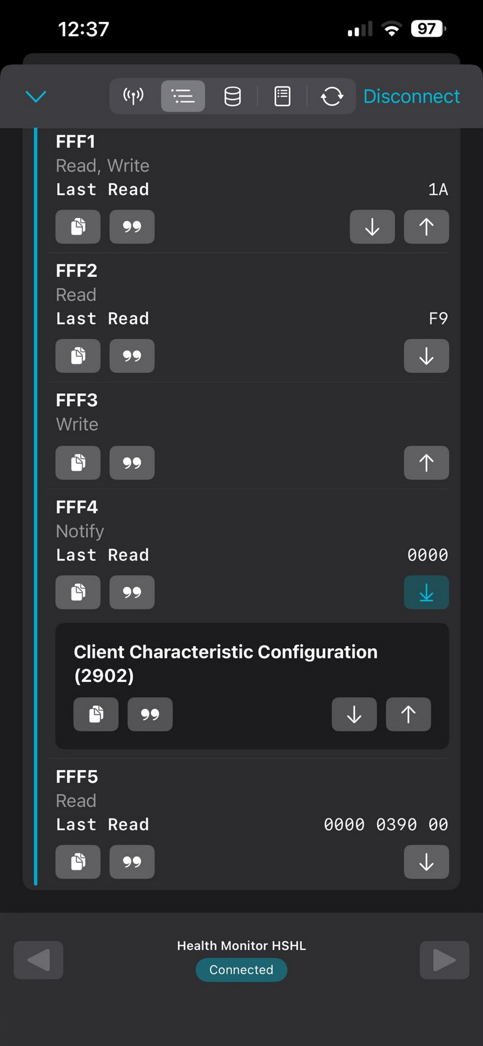
Independent Proof: nRF Connect
Third-party BLE scanner — zero dependency on this project's own code
Device advertising as “Health Monitor HSHL”, confirmed
All five GATT characteristics populated with live values
CHAR4 Notify subscription delivering real-time updates
Figure 6.4
Cloud, FHIR & Evidence
14

Slide 16
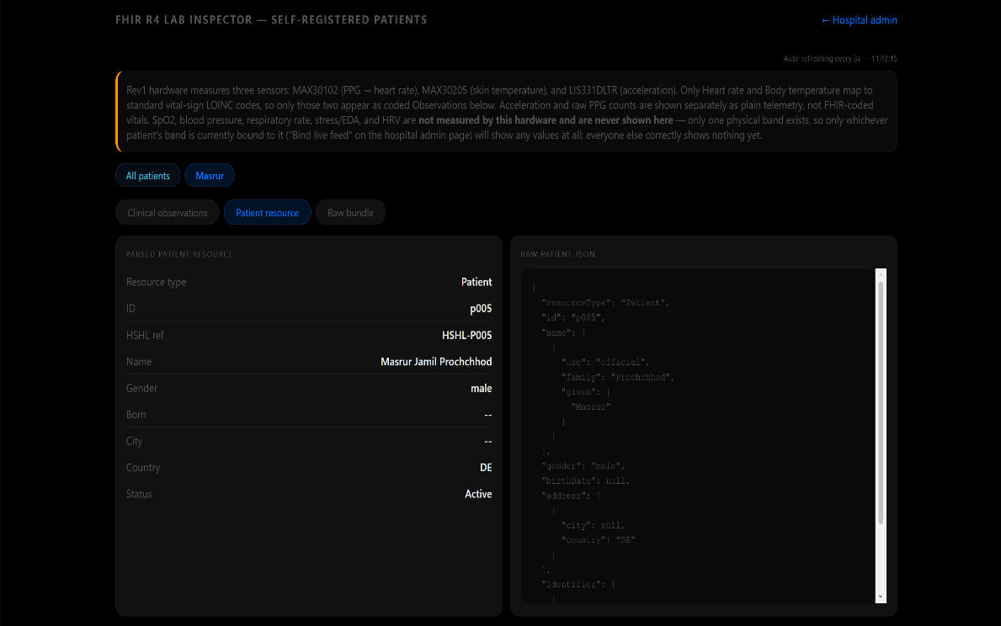
FHIR R4 Interoperability
Firestore data converted into standards-compliant HL7 FHIR resources
Only heart rate & temperature mapped to coded LOINC Observations
Deliberate: Rev1 doesn't measure SpO₂, BP, or HRV — nothing fabricated
Built for hospital-side integration, independent of the dashboard
Figure 5.3 — FHIR R4 Lab Inspector
Cloud, FHIR & Evidence
15

Slide 17
Standalone Power Test
Battery only, debug probe fully disconnected — the configuration a finished wearable actually runs in:
Evaluation & Limitations
16

Slide 18
Known Limitations — Reported Honestly
!
U102 Regulator Fault
!
P10 Jumper Conflict
1.8V rail fails to reach rated output on battery alone — prevents fully standalone operation on this physical unit
Debug probe + external power connected simultaneously degrades nRESET
✓ FIX
✓ FIX
Two fixes identified: bridge to 3.3V via R121, or replace U102
Only affects development, not normal worn use — hardware fix proposed for Rev2
Evaluation & Limitations
17

Slide 19
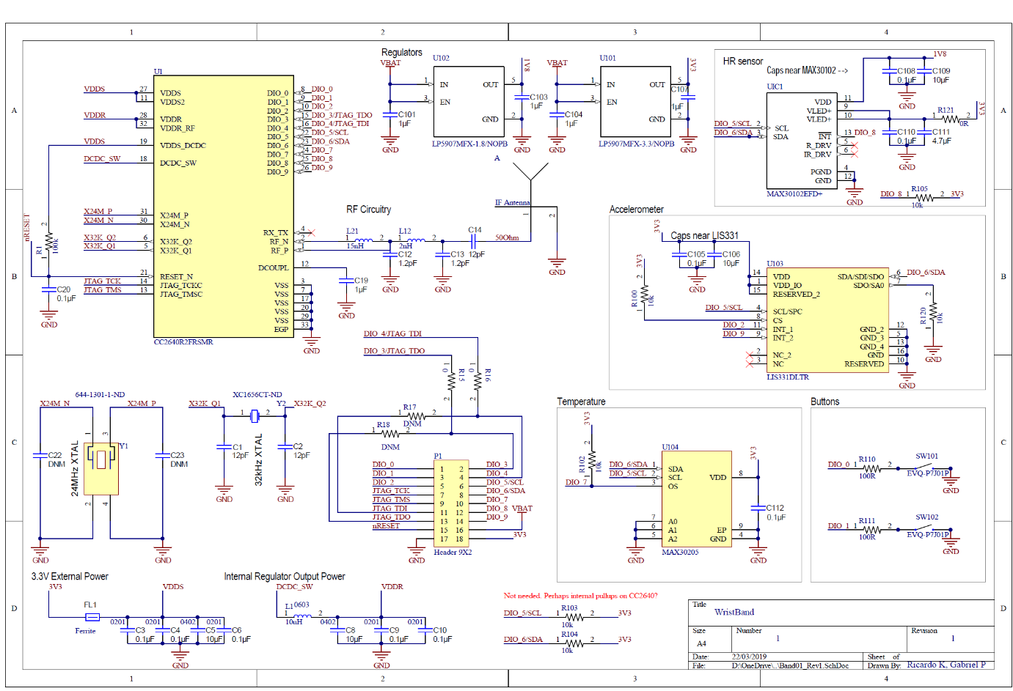
Outlook: Already Adopted into Rev2
Power Architecture
Replace the P10 jumper with a proper power-OR circuit
Firmware Process
Audit every SDK board file against the real schematic first
Standalone Reliability
Test battery-only operation early and repeatedly
Figure J.1 — Band01_Rev1 schematic
Outlook & Summary
18

Slide 20
WRAPPING UP
Summary
Turned an unexplained Bluetooth fault into a fully documented root cause
Brought up 3 sensors, a full GATT profile, and an OLED — each independently verified
Migrated the toolchain through 10 diagnosed build-system issues
Built a live, standards-compliant (FHIR R4) cloud data pipeline
Reported open limitations honestly — not hidden
Outlook & Summary
19

Slide 21
References
Full 16-entry IEEE bibliography is provided in the written report.
[1] Texas Instruments, “CC2640R2F SimpleLink Bluetooth Low Energy Wireless MCU,” Datasheet SWRS204, 2020.
[6] W3C Web Bluetooth Community Group, “Web Bluetooth Specification,” Editor's Draft.
[2] STMicroelectronics, “LIS331DLH / LIS331DLTR MEMS Digital Output Motion Sensor,” Datasheet.
[7] Google, “Cloud Firestore Documentation,” Firebase Developer Documentation.
[3] Analog Devices / Maxim Integrated, “MAX30205: Human Body Temperature Sensor,” Datasheet.
[8] HL7 International, “FHIR R4 (Fast Healthcare Interoperability Resources), Release 4.”
[4] Bluetooth SIG, “Bluetooth Core Specification,” Vol. 3, Part G — GATT.
[9] Regenstrief Institute, “LOINC (Logical Observation Identifiers Names and Codes).”
[5] Analog Devices / Maxim Integrated, “MAX30102: High-Sensitivity Pulse Oximeter and Heart-Rate Sensor,” Datasheet, 2018.
References
20

Slide 22
Thank You
Questions?
Thank You
21

